Slide 1

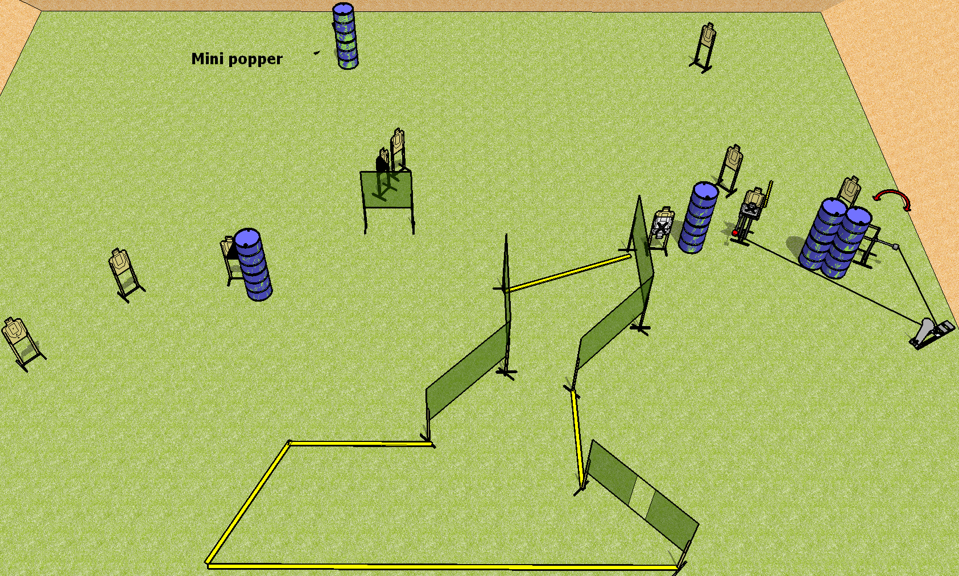
 | Dothan Practical Shooters – USPSA Match Whatchoo Got Course Designer : Drew Coleman Bay: B4
Round Count 24 rounds 11 USPSA 1 colt popper, 1 mini popper
Equipment List Swinger + Max Trap + activator 12 wall feet 1 left + 1 right diag 11 targets (9 + 2 NS)

Slide 2
Whatchoo Got
Written Stage Briefing
Scoring: Comstock Rounds: 24 rounds
Targets: 11 USPSA, 2 steel
Handgun start position: anywhere completely outside the shooting area, wrists below belt. Handgun is loaded and holstered.
PCC start position: anywhere completely outside the shooting area, stock on belt. Loaded carbine is held with both hands, safety on.
Stage Procedure: on the audible start signal, engage targets as they become available from within the shooting area. The max trap and swinger are both activated by P2 and remain visible at rest.

